Slide 1
Dried fish stories from Asia
Visualizing social economies
South and Southeast Asian vignettes?

Slide 2
Dried and fermented fish
South and Southeast Asians have dried and fermented fish as a means of preservation and as part of their culinary traditions for centuries. People love it or hate it. Mostly they love it. Because it has distinct and irresistible flavours. Notwithstanding those who cannot stand its smell.
Smell and taste. Dried fish evokes two of our primordial senses. The cultural value we give to dried and fermented fish is inextricably linked with our sensory journeys through time.

Slide 3
Smell
Dried fish emits an aroma of ‘fishiness’ mixed with salt, sea and sand. For some, the scent is familiar and comforting. Others hold their noses in disdain. Some men will not take wives from groups who eat dried fish. Traders might come to markets to buy dried fish reluctantly. There are gods who have run away from the smell.

Slide 4
The aroma of dried and fermented fish
Northeast India, 2018
‘The memory is cloudy. As was the day. Black lines of pine against the cold, colourless sky as I walked home from school. But on my lunch plate, there was a dab of darkish maroon. As I ate, slowly mixing the shidol chaatni — a mash of dried, fermented fish, smooth but for the prick of delicate, easy-to-chew bones — with the rice, the afternoon’s gloom seemed to lift. My eyes watered from the heat of chilli and garlic, my ears reddened, my mouth came alive with a burst of flavours. I was warmed. Hours after the meal, I could find it on my fingers — the smell, like a secret, hot, fierce, and illicit.’
(Dutta, A. 2018. The fiery flavours of East Bengal’s dried and fermented fish are all the notes of life. India Express, 23 December 2018.)

Slide 5
Colonial disdain for dried fish
Yandun, Burma, 1880
The English apparently regarded ngapi, a fish paste in the Burman cuisine, with disfavour. An overzealous Assistant Commissioner attempted to ban ngapi during a cholera epidemic in the mistaken belief that the heavy smell of the fish paste was its cause. This resulted in petitions and very nearly a riot, which was averted by the Chief Commissioner by transferring his Assistant to another station. “Nevertheless, Yandun is not a charming place of residence to a man with a sensitive nose”.
(From Shway, Y. 1882. The Burman: His Life and Notions).

Slide 6
They will not marry dried fish eaters
Bangladesh?
Gameranga villagers do not consider daughters of Kathi village as desirable wives because they eat dried fish.
(Kotalova, J. 1996. Belonging to others: Cultural construction of womenhood in a village in Bangladesh.)

Slide 7
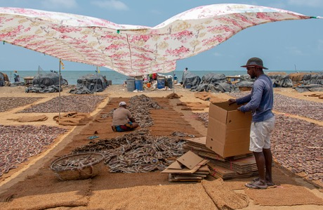
I would not wish to return
Goods, including dried fish, were transported on padda (covered) boats on Hamilton Canal to and from Negombo in the past.
(Photo: www.damithah.wordpress.com)
Negombo. West coast of Sri Lanka
Known for centuries as a major trading town and wholesale market for dried fish. However, not all traders were enthusiastic about visiting Negombo.
Handhapane narakadha meegamu yanna
Ema paane narakadha veladam ganna
Be raale karawala gandha uhu lanna
Mathu waare nopathan meegamu yanna
Is it not bad to go to Negombo in the moon light and engage in trading? Dear friend! I cannot bear the odour of dried fish I would not wish to return to Negombo
Sinhalese Folksong (Anonymous, no date)
Link to voice recording?
Dried fish market, Negombo
(Photo: www.freejpg.com.ar)

Slide 8
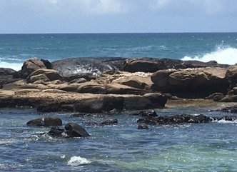
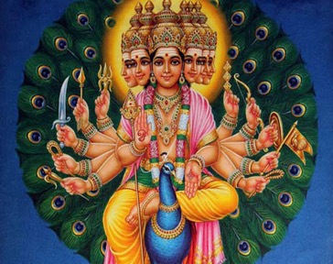
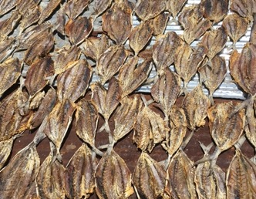
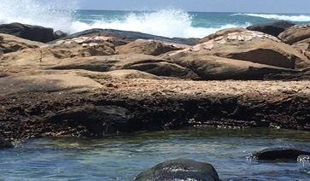
The god who ran away from the smell of dried fish
Devinuwara, south coast of Sri Lanka, 2020. The town of gods.
‘This rock [outcrop] is called devagala – the god’s rock. God Kataragama [also known as Murugun] landed here from across the seas. Our ancestors were drying fish on the rocks. He did not want to stay here. He said there was a bad smell coming from the dried fish. Therefore he went away to his present shrine on the hill [in the southern interior]. Our ancestors built a small shrine to commemorate his visit and we continue to come here in procession every year during the Vishnu temple festival’. (Female fish processor)
God Kataragama/Murugan (Photo: www.kataragama.org)
Fish drying on rocks and rooftop at Dewinuwara (Photos: Nireka Weeratunge)

Slide 9
Taste
Dried fish is a main dish, an accompaniment, a condiment, a rice puller. It adds value to rice and vegetables in many Asian cuisines. There are thousands of recipes. It is a comfort food that migrants carry or receive across the oceans to remember home. A unique food that defines their identities. Some gods desire it as an offering.

Slide 10
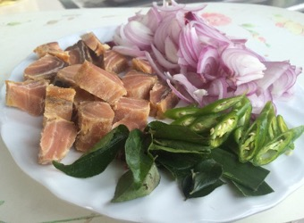
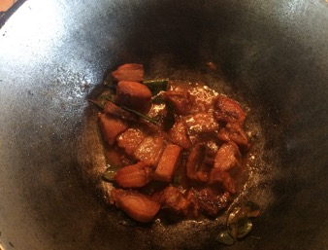
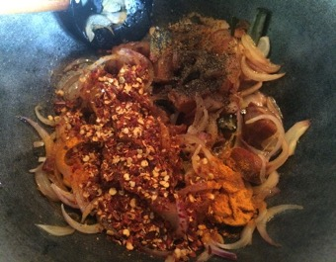
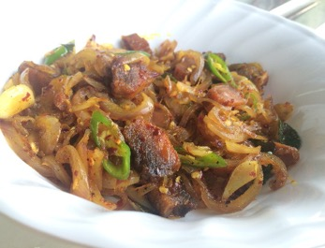
A thousand ways to prepare and eat it
Devinuwara, south coast of Sri Lanka, 2020
‘We like stir-fried and deep fried [dried fish] best. We also prepare it with coconut milk, chilli coconut milk and roasted. Sometimes we make a sambal [relish] with chilli…We did the same during our grandparents’ time. But now people also prepare devilled fish, fried rice and other things. There was a lot more tuna during that time… We learnt to make these dishes from our mothers. But it doesn’t taste as good as our grandmothers’… We cook it [dried fish] for food donation stalls and almsgivings too.’
(Female fish processor)
Karavala badun - Tempered dried fish
(Photos: www.anomaskitchen.com)

Slide 11
A thousand ways to prepare and eat it
Kerala?

Slide 12
A thousand ways to prepare and eat it
Other teams?

Slide 13
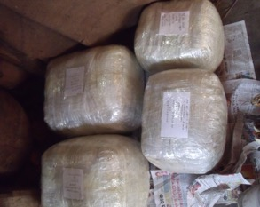
A memory of home, a sense of belonging across the oceans
Bangladesh?
Dried fish shop targeted at UK diaspora market in Sylhet, Bangladesh
(Photos: Ben Bolton)

Slide 14
A memory of home, a sense of belonging across the oceans
Cambodia: Prahok?

Slide 15
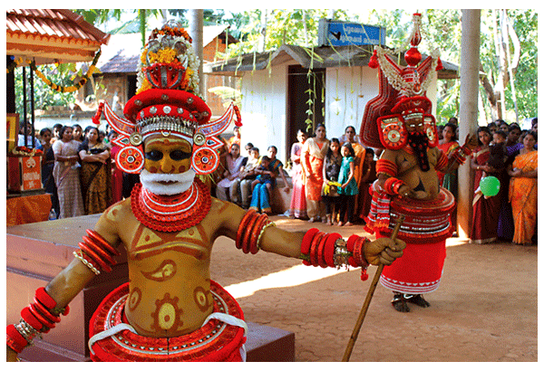
The god who likes the taste of dried fish
Kerala – the story of Muthappan
Muthappan, a principal deity in the Theyyam ritual tradition, Kerala
(Photo: www.artnewsnviews.com)

Slide 16
Dried and fermented fish
At the core of Asian culture, cuisine, rituals and journeys.
Food for people and food for the gods.

